Slide 1

It’s election time!
Your Voice, Your Wales

Slide 3

Notes:
Does anyone know what the name of this Building is? – the Senedd
The Senedd is in Cardiff Bay.
What does the word Senedd mean? – Senedd is the Welsh word for ‘Parliament’, which means somewhere for a group of people to come together to discuss and make decisions. The Senedd in Wales has a role in discussing and making decisions on things that affect our everyday lives here in Wales.
But how did we get to this point? How does the Senedd exist?

Slide 4

Notes:
We’re going to watch this short video which shows you how the Senedd came to exist here in Wales and what it’s role is.
We now know that the Senedd, as it is today, has full law making powers here in Wales. It’s able to discuss, make decisions and turn those decisions into laws.

Slide 5
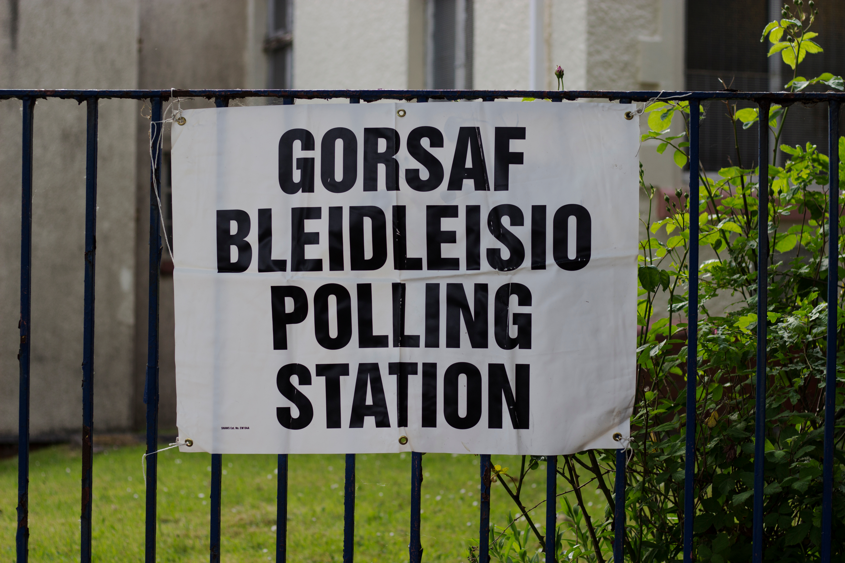
Notes:
As we also heard in that video – since 2020, the voting age for Senedd Elections has been lowered from 18 to 16.
But what does voting in the Senedd Election mean? What are you voting for? Why is it so important to use your right to vote during the next election?

Slide 6









The Senedd is responsible for many topics that affect our day-to-day lives.
Health
Food
Education
Fire and Rescue
Services
Sports
Environment
Agriculture
Housing
Notes:
The Senedd, as we can see, is responsible for many topics that affect our day-to-day lives.
When voting in the Senedd Election, we are voting for the best people to be meeting in the Senedd and making these decisions on our behalf.

Slide 7
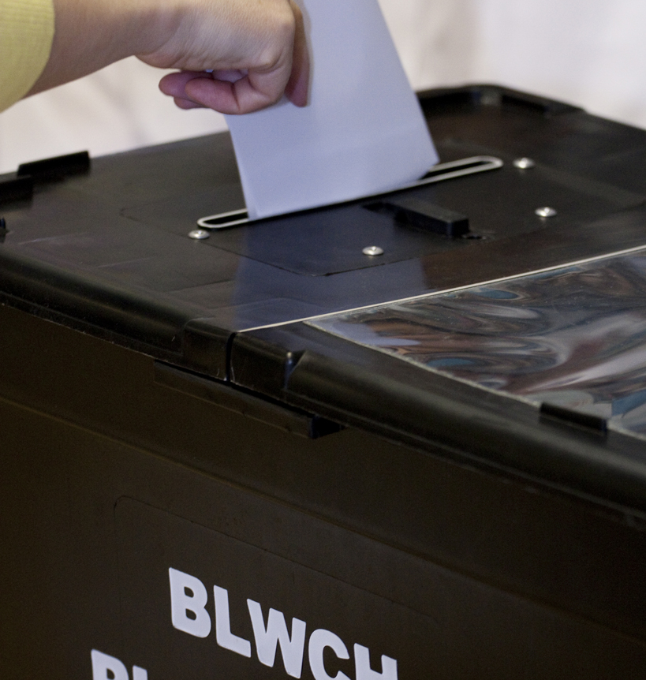
Members of the Senedd
Members of the Senedd are elected to represent us in the debating and passing of laws on these devolved subjects in Wales.
If you were a Member of the Senedd for a day, what new law would you make?

Slide 8




Political Parties
At the moment, there are five political parties in the Senedd.
Notes:
Members of the Senedd are members of political parties. Currently there are 5 parties in the Senedd. Depending on how the people of Wales vote, there could be additional parties in the Senedd following the election and there could also be independent members who aren’t a member of a party, they stand on their own.
Why have political parties? Yes – they all have different beliefs on how to run Wales as a country. The put their beliefs or promises in something called a manifesto.

Slide 9

Manifesto
A list of promises.
Outlines what the party stands for and how they intend to effect change.
Each party will publish their manifesto in the run-up to an election.

Slide 10

Our class Senedd Election
Working in groups you will create your own political party.
Discuss ideas to develop education, health, environment and our communities in Wales.
Write a manifesto.
A manifesto is a list of ideas that you want to do to improve the country.
It could include ideas like spending money on hospitals, improving schools or laws to protect our environment.
Present your ideas to the class.
Listen to the ideas of the other parties in the class.
Vote!

Slide 11
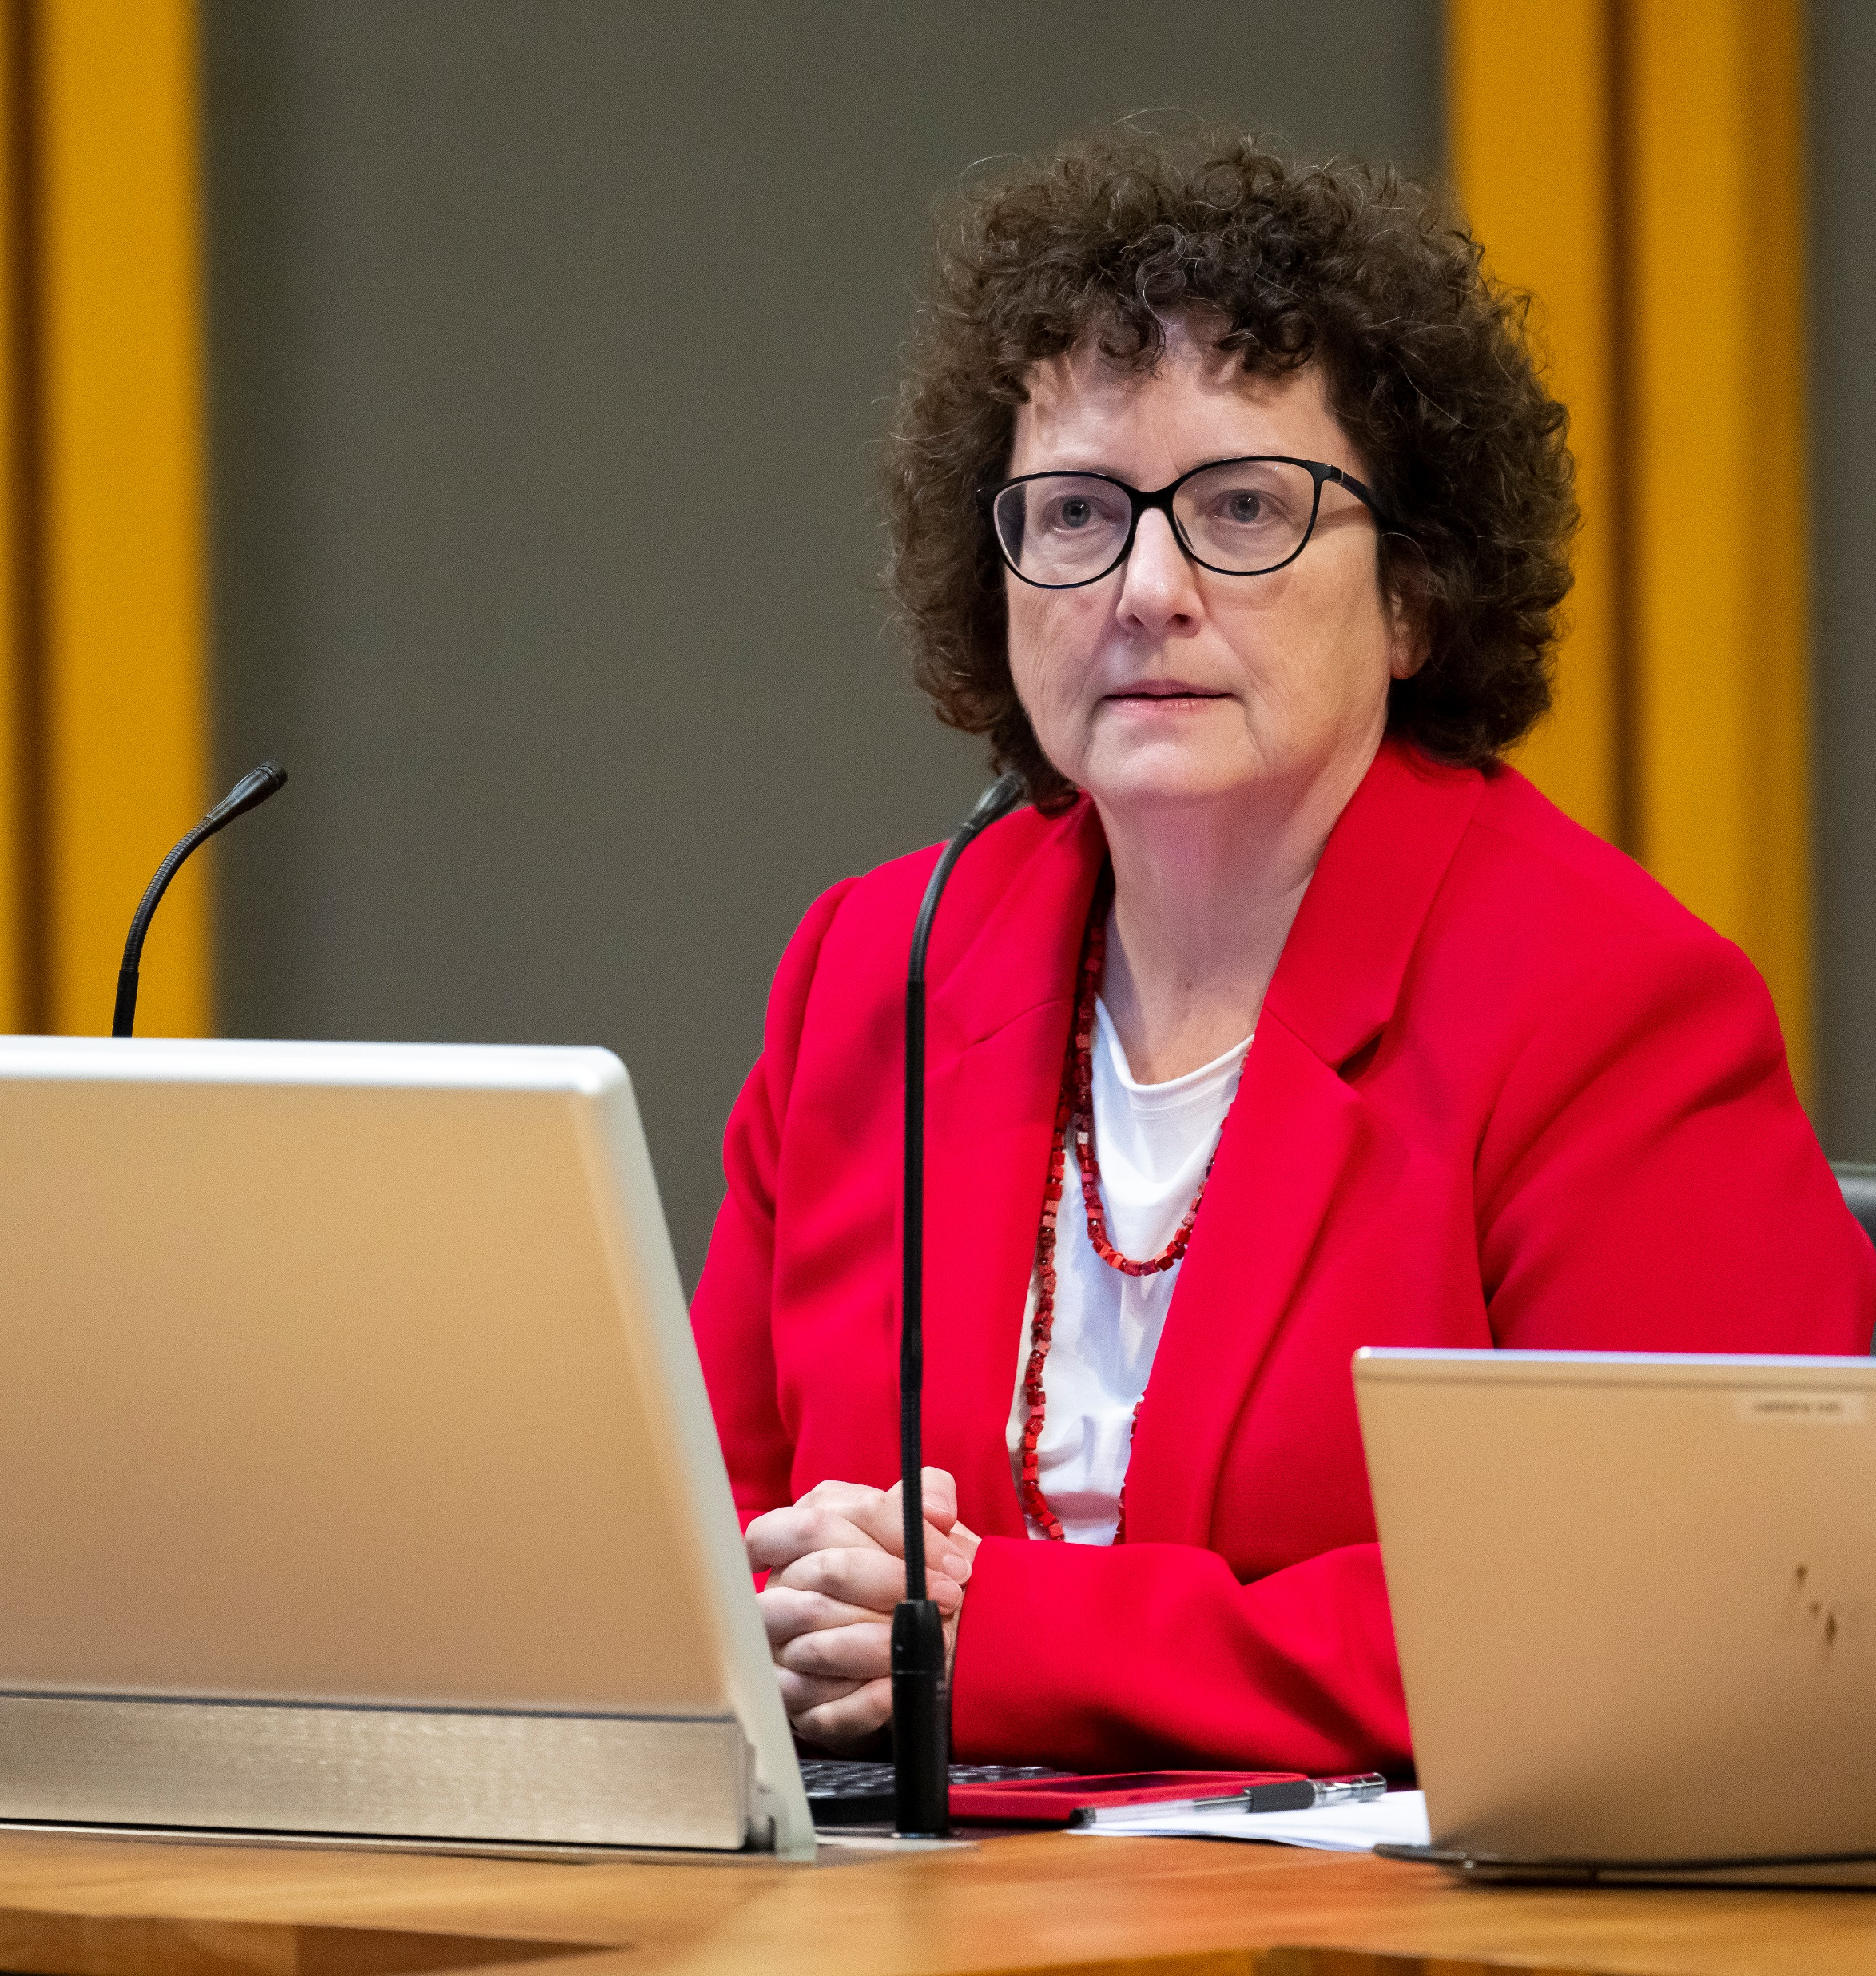
Select a Presiding Officer for your Group
Just like the Presiding Officer in the Senedd, your group should choose one person to make sure, as a group:
that everyone has the opportunity to put their views into discussion.
that you vote to pick the best ideas
that all tasks are completed on time.
Maniffesto
Maniffesto

Slide 12

Write your own maniffesto
Your manifesto must include ideas to develop education, health, the environment and communities in Wales.Defnyddiwch y cardiau pwnc i helpu gyda syniadau.
Make sure everyone has a chance to think of ideas.
As a party, you will need to vote to choose which ideas will be used in your manifesto.
It should be ensured that you give reasons for choosing your ideas and how it will work.

Slide 13

Your Campaign
Once you've agreed on your manifesto, you should work on your election campaign to persuade people to vote for you.
Decide on a name for your party, think about using spelling or rhyming words to make sure the name is memorable.
Create a colourful poster showing your ideas for your manifesto.
Write a speech that explains each of the ideas of your manifesto. Share the speech between your party members and make sure you practise before the election
Colour the rosette for your party

Slide 14

The election!
Each party will have the opportunity to present their ideas to the class.
Listen carefully to the ideas of each party before deciding who gets your vote.
Do you agree with their ideas?
Are their ideas realistic?
Is their presentation well organized and confidently presented?

Slide 15
Vote
Everyone will have the opportunity to vote.
Everyone is given a ballot paper that lists the name of each party.
To vote enter an x in the blank box next to the name of the party you wish to vote for.
It's a secret ballot, so you don't need to write your name on the paper or tell anyone which party you've chosen to vote for.
Fold your paper in half and place it in the ballot box.
The party with the most votes will win the election.

